Slide 1
Industrial Orientation
Presentation

Slide 2
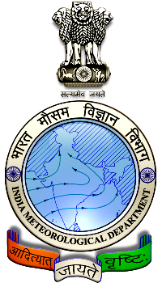
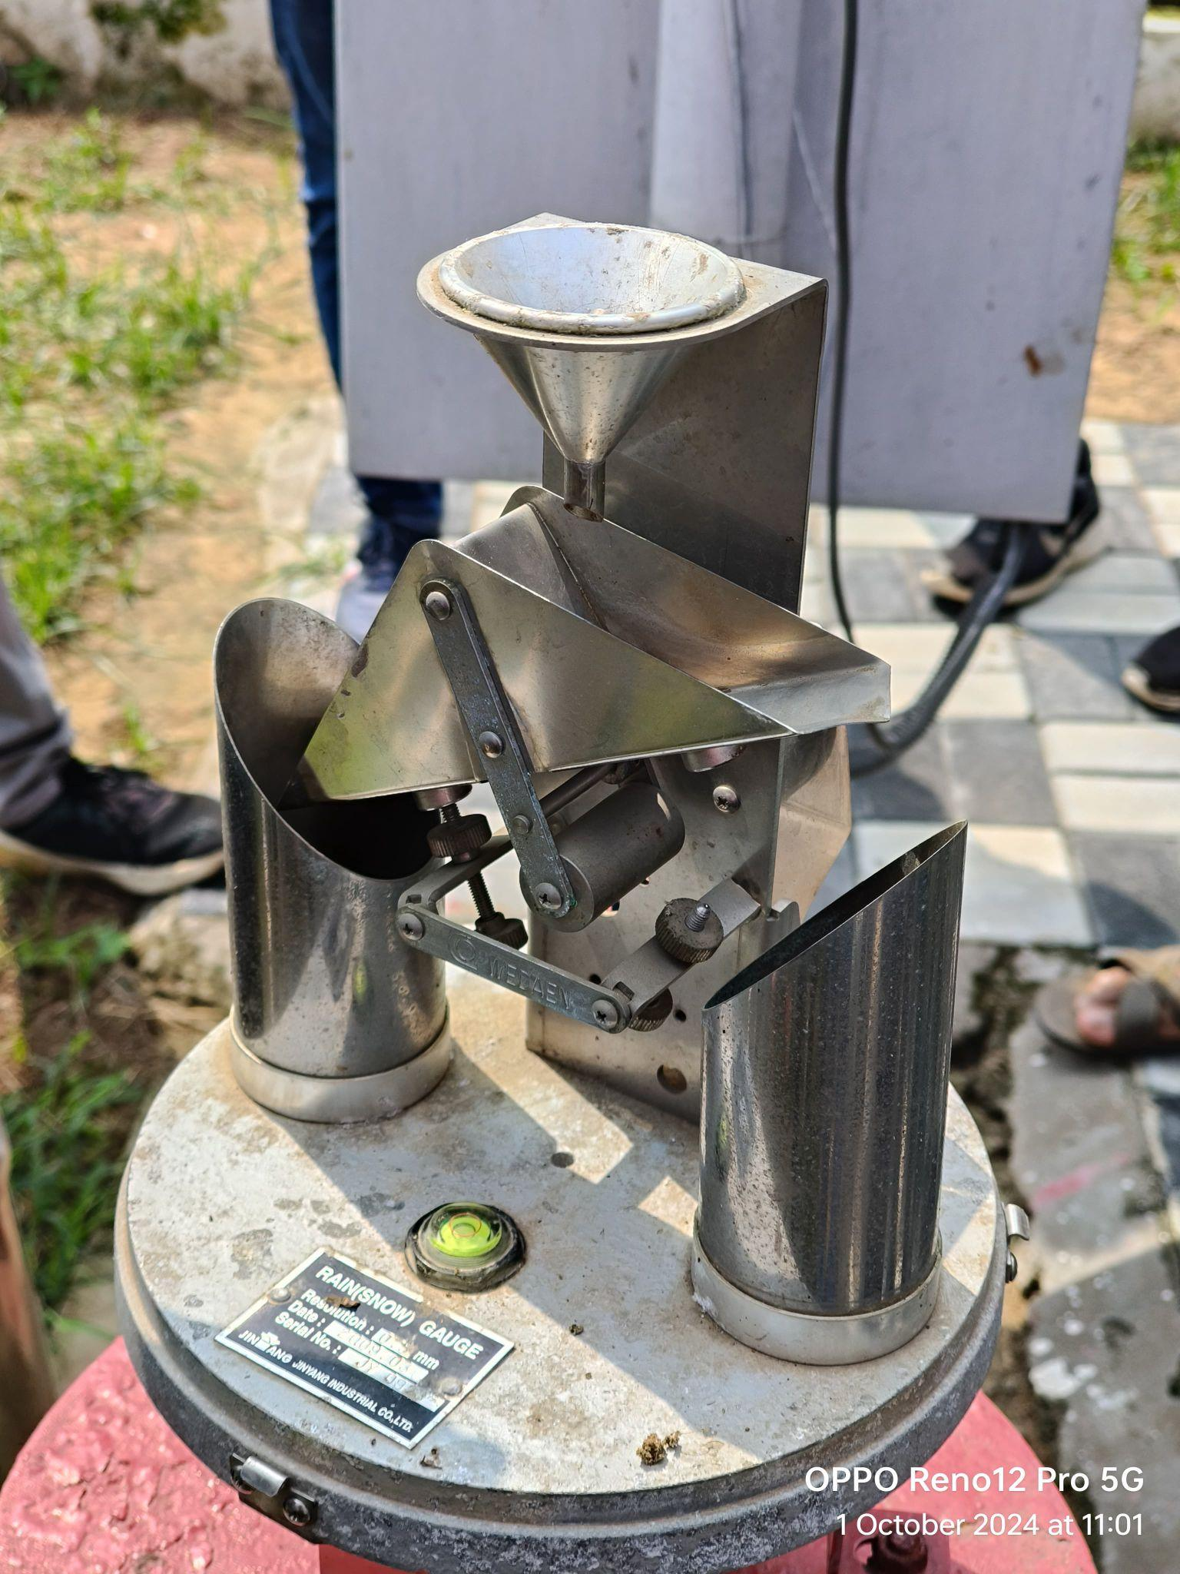
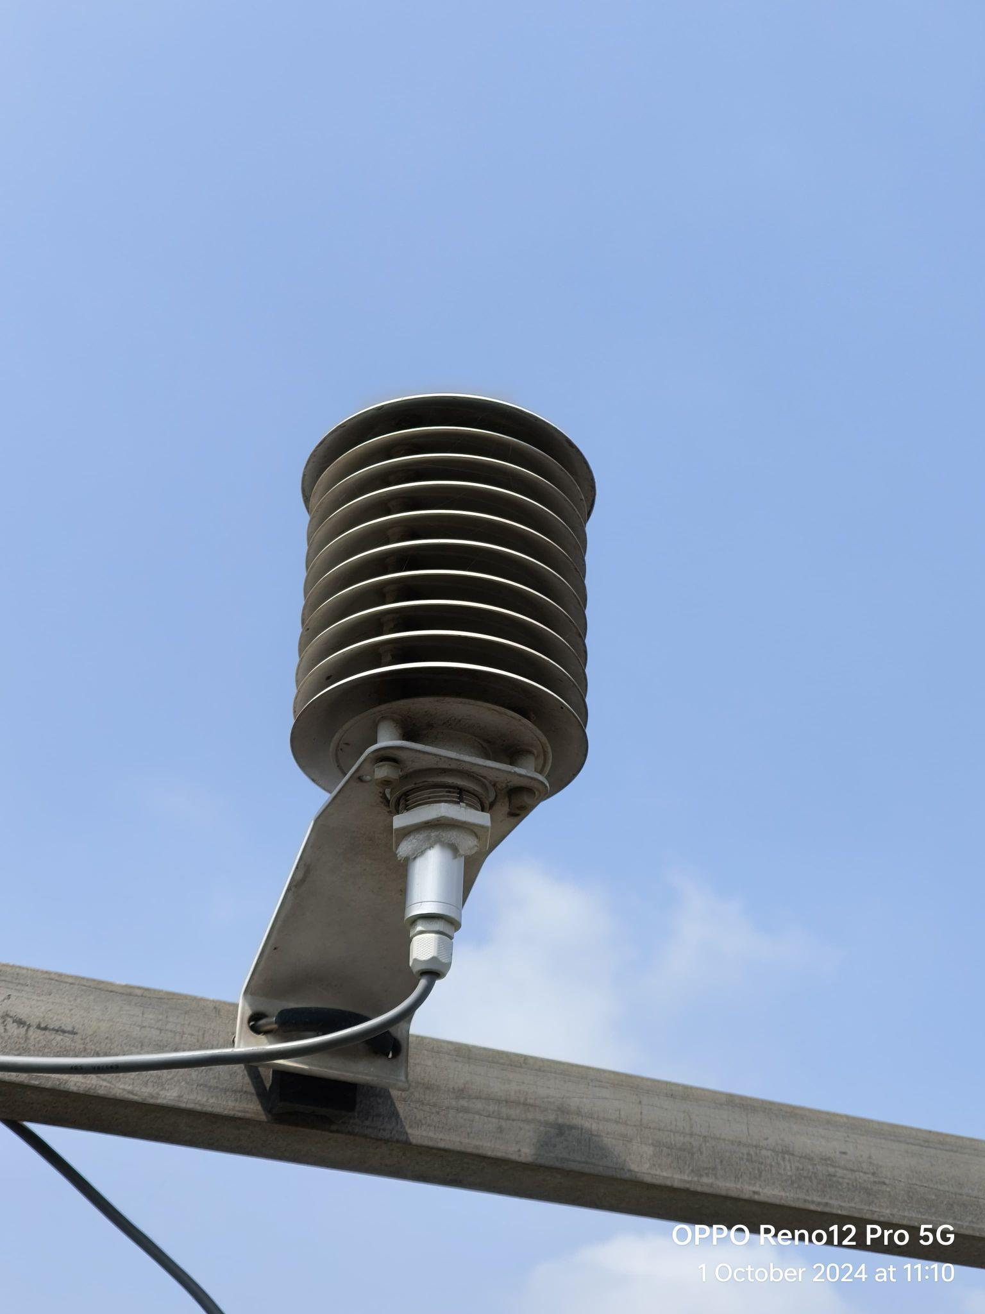
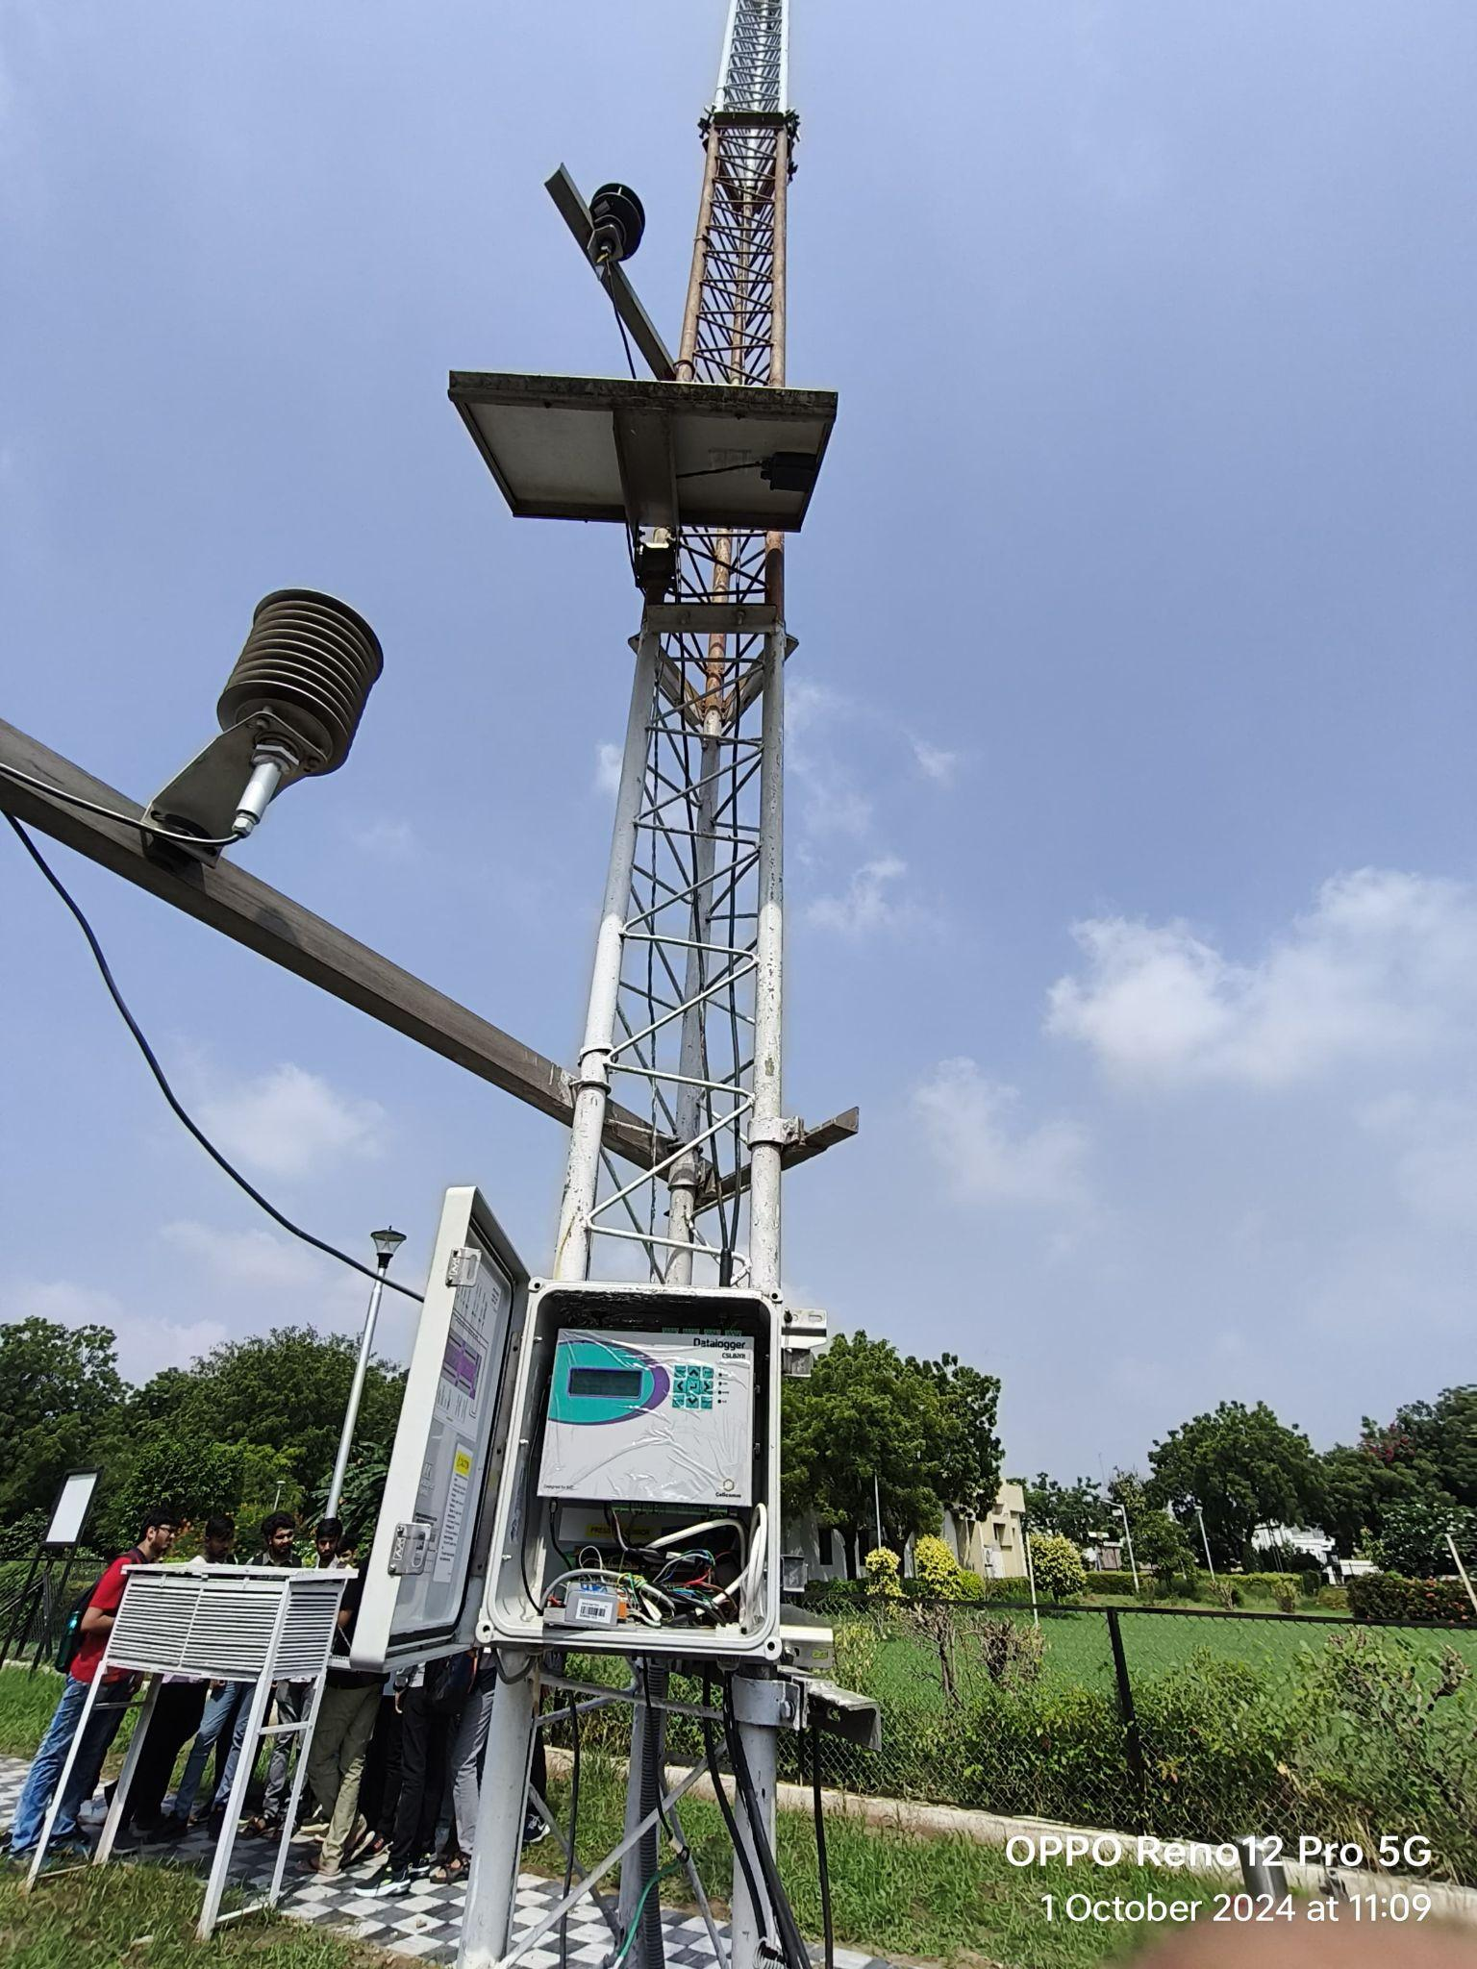
India Meteorological Department (IMD), Ahmedabad - Overview
Established in 1893; full-fledged Met Centre since 1974
Provides weather forecasts, aviation meteorology, cyclone warnings, and agro-advisories
Plays a crucial role in disaster management and climate research
Uses Doppler radar, automatic weather stations, and upper-air observations

Slide 3
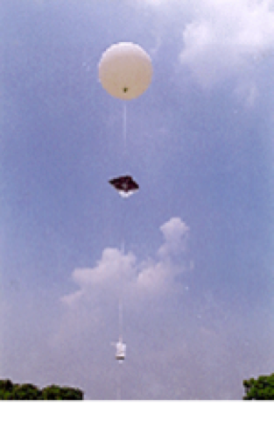
IMD Ahmedabad – Computer Engineering Applications
Machine Learning models for weather prediction and data analysis
Data visualization and real-time forecast dashboards
Automated data collection from sensors and weather balloons
Integration of IT for disaster early warning systems

Slide 4

eInfochips – Overview
Founded in mid-1990s, global product engineering and semiconductor services provider
Expertise in IoT, AI, cloud, and embedded systems
Serves Fortune 500 clients across automotive, healthcare, aerospace, and consumer electronics
Known for innovation and end-to-end product development

Slide 5
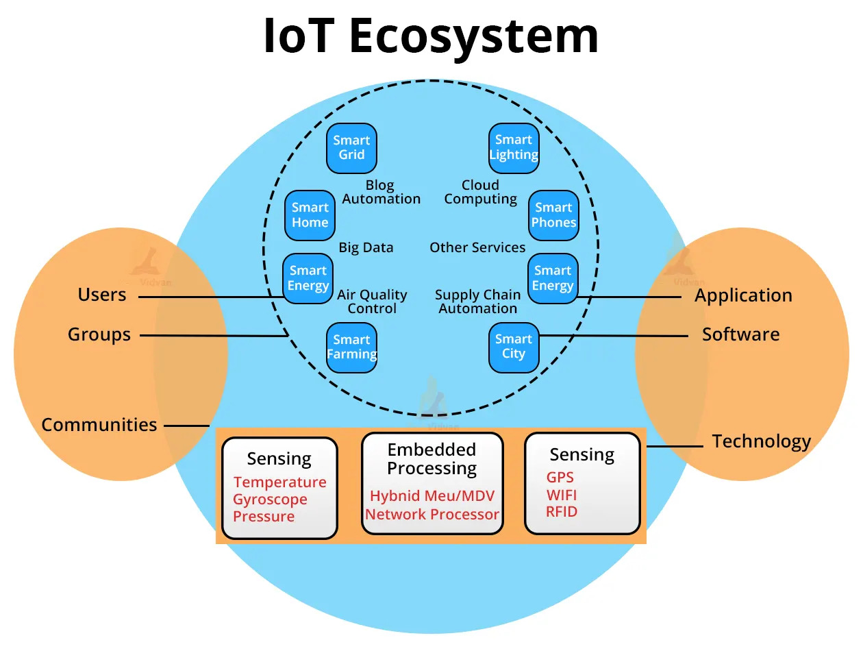
eInfochips – Computer Engineering
Applications
Embedded software development and FPGA/ASIC design
IoT product development and integration
AI/ML solutions for automation and analytics
Cloud computing and DevOps practices for scalable products

Slide 6
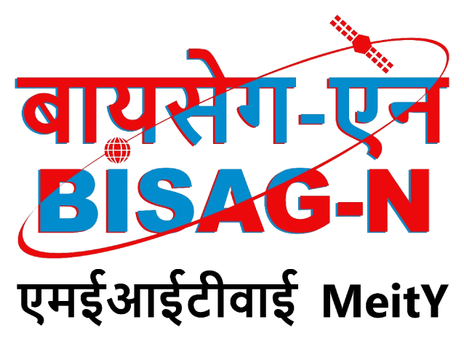
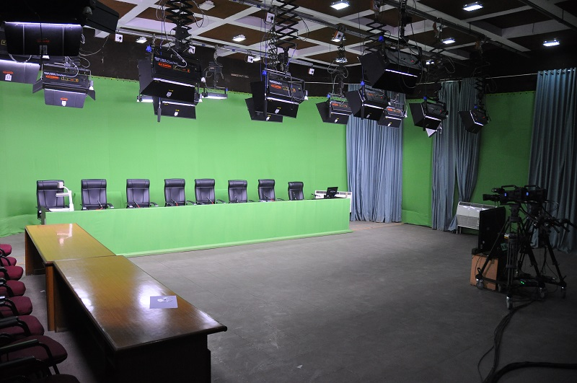
BISAG‑N (Bhaskaracharya National Institute for Space
Applications & Geo‑informatics) - Overview
Established in 1997 (as RESECO, renamed BISAG in 2003, now BISAG‑N)
Focus on geo‑informatics, remote sensing, and SATCOM applications
Supports sectors like agriculture, disaster management, urban planning, and education
Provides SATCOM-based educational TV broadcasting

Slide 7
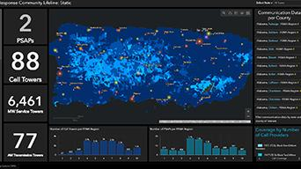
BISAG-N – Computer Engineering
Applications
GIS and satellite data processing systems
Cloud-based geospatial analytics and visualization tools
Decision support systems for government and industry
Educational content delivery through digital broadcasting platforms

